Slide 1

Chapter 7 – part I

Slide 2
OUTLINE
  Gravitational potential energy.
  Mechanical energy conservation.
  Problems.

Slide 3
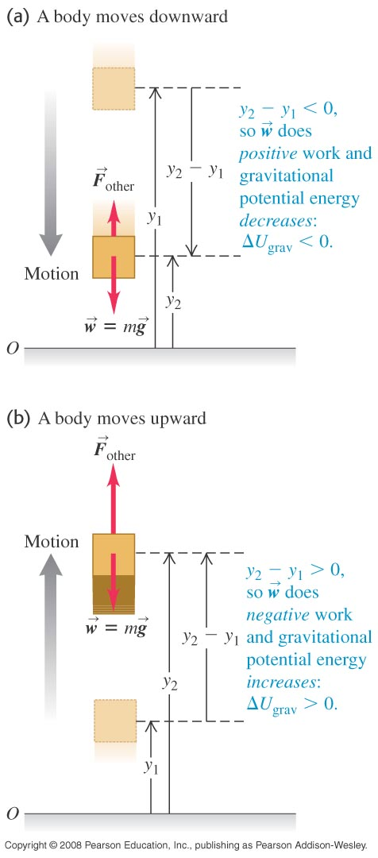
Gravitational potential energy
  Energy associated with position is called potential energy.
  Gravitational potential energy is U_{grav} = mgy.
  Figure at the right shows how the change in gravitational potential energy is related to the work done by gravity.

Slide 4
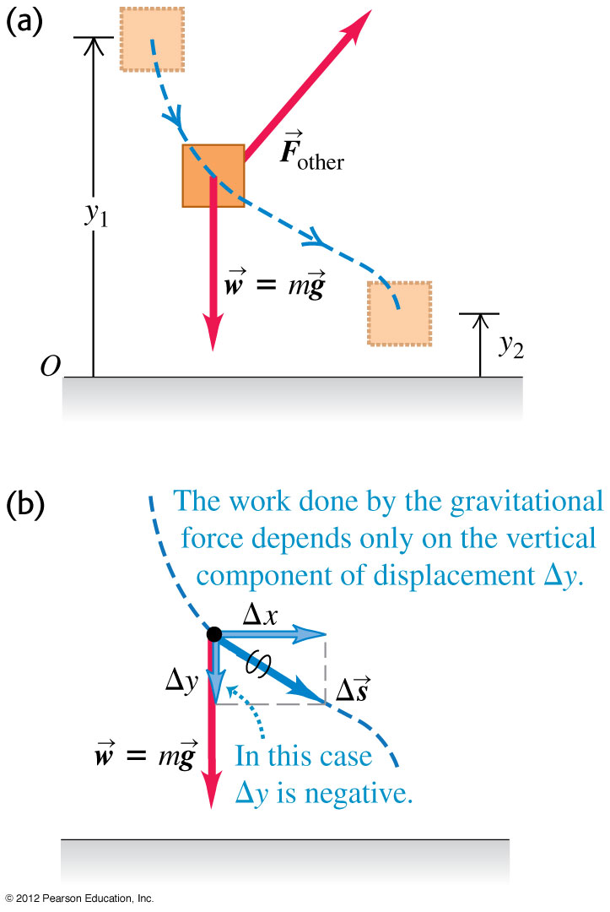
Work and energy along a curved path
We can use the same expression for gravitational potential energy whether the body’s path is curved or straight.

Slide 5
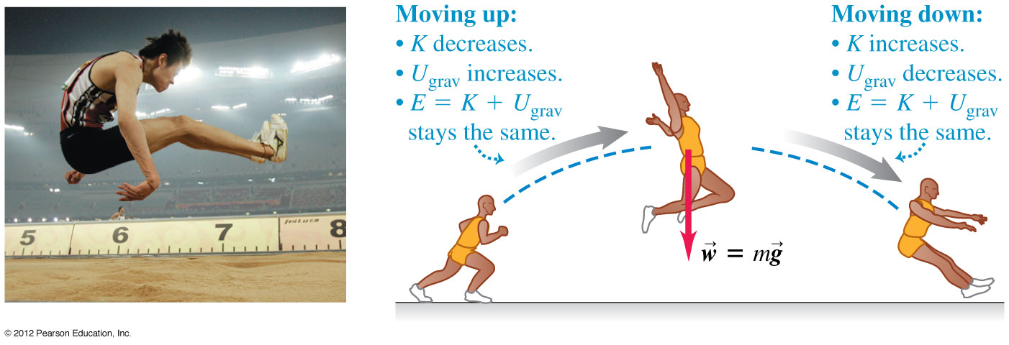
The conservation of mechanical energy
  The total mechanical energy of a system is the sum of its kinetic energy and potential energy.
  A quantity that always has the same value is called a conserved quantity.
  When only the force of gravity does work on a system, the total mechanical energy of that system is conserved. This is an example of the conservation of mechanical energy. Figure below illustrates this principle.

Slide 6
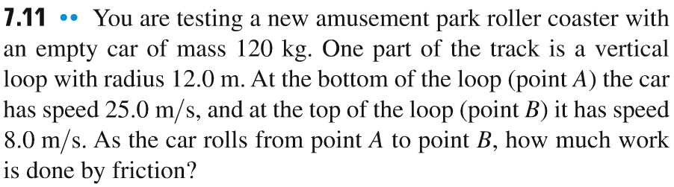
Problem #1

Slide 7
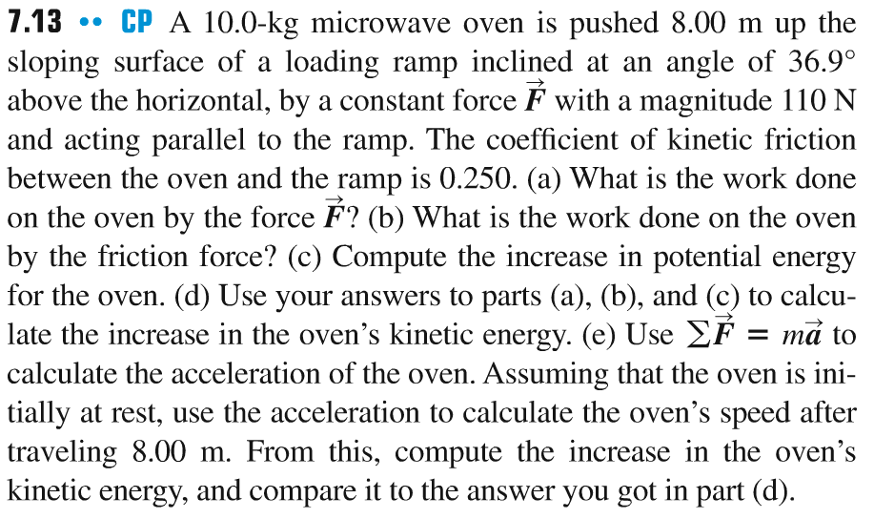
Problem #2

Slide 8
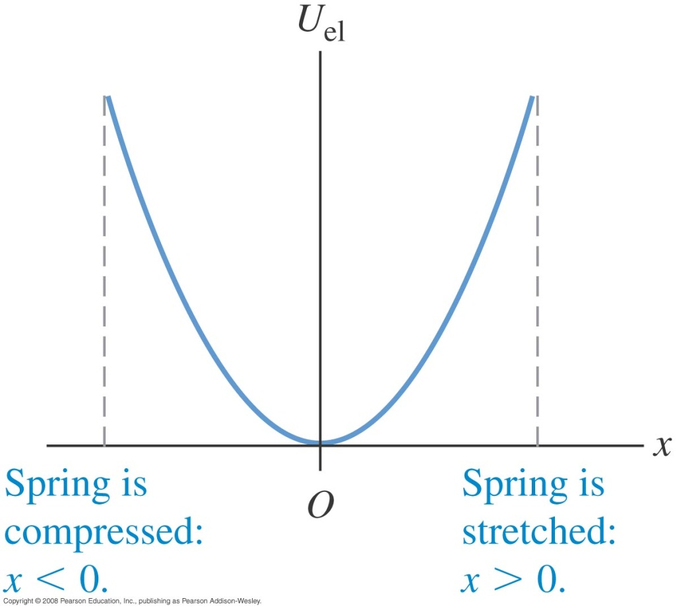
Elastic potential energy
  A body is elastic if it returns to its original shape after being deformed.
  Elastic potential energy is the energy stored in an elastic body, such as a spring.
  The elastic potential energy stored in an ideal spring is U_{el} = 1/2 kx².
  Figure at the right shows a graph of the elastic potential energy for an ideal spring.

Slide 9
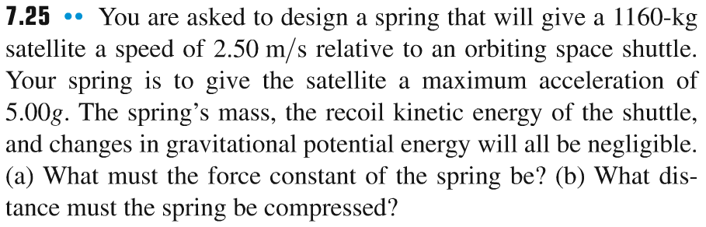
Problem #3

Slide 10
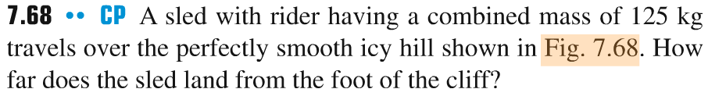
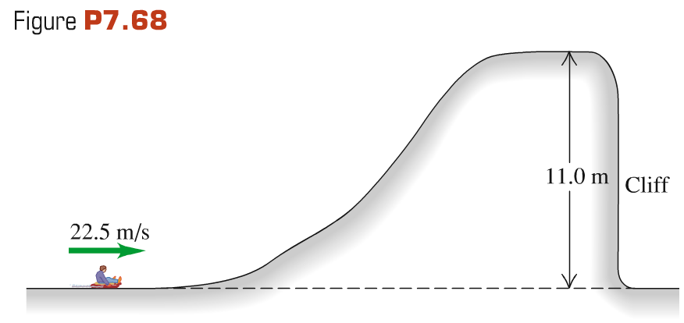
Problem #4

Slide 11
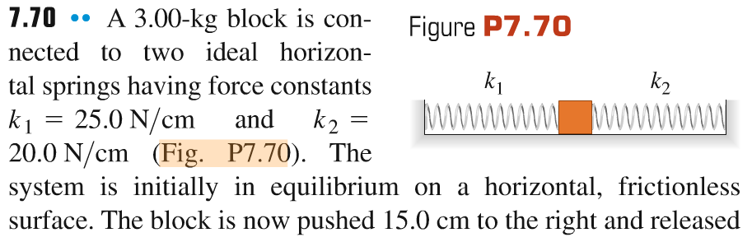
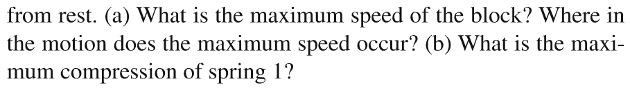
Problem #5

Slide 12
Problem #6
Block of mass 5 kg (starting from rest) slides down the ramp inclined at an angle θ above horizontal. Block moves the distance 5 m along the ramp and at the end of it encounters a spring with the force constant 1000 N/m compressing it by 50 cm.
(a) Find the angle θ if the ramp is frictionless.
(a) Find the angle θ if the coefficient of kinetic friction between the block and the ramp is 0.1.

